Slide 1
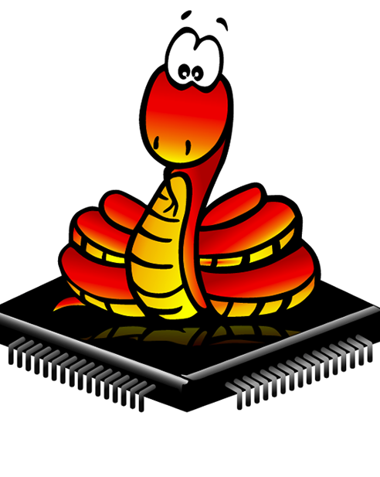
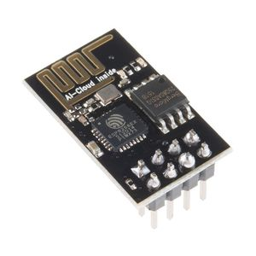

Micropython With ESP8266
for the Internet of Things

Slide 2

What is MicroPython ?
MicroPython3 was created and is maintained by Damien P. George and other contributors.
MicroPython aims to implement the Python 3.4 standard
it was designed to be a lean, efficient version of the Python 3 language and installed on a small microcontroller.
MicroPython effectively functions like a small operating system, running user programs and providing a command interpreter (REPL).
https://github.com/micropython/micropython

Slide 3
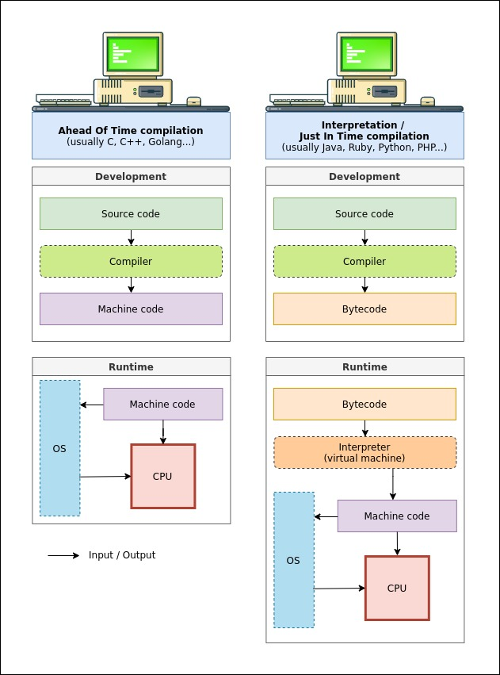


































COMPILED VS. INTERPRETED

Slide 4












































COMPILED
INTERPRETED
Computer
Computer
C or C++
IDE editor
IDE editor
ESP8266
Micropython
Source Code
Source Code
Compiler
Interpreter
ESP8266
Flash Memory
Flash Memory

Slide 5















MicroPython Features
Interactive Interpreter
by connecting with a USB cable (or in some cases over WiFi) webrepl.
Python Standard Libraries
socket programming , Network , Parsing JSON , string manipulation.
Hardware-Level Libraries
read analog digital data, and (PWM),SPI ,UART,I2C , ADC , Timer , WDT , RTC.
Extensible
feature for advanced users to implement some complex library at a low level (in C or C++) and include the new library in MicroPython .

Slide 6
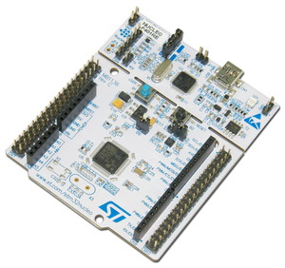
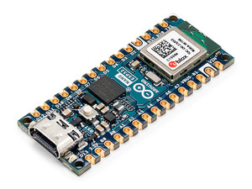

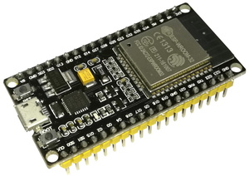
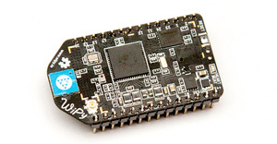
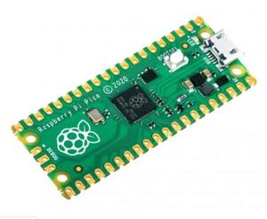









What Does MicroPython Run On?
teensy 4.0
Arduino nano esp32
Nucleo F401RE
ESP32
ESP8266
Pico
WiPy Module

Slide 7
1 – Install Python on OS machine
2 – pip install esptool
3 – Thonny IDE

Slide 8
THANK YOU

